Slide 1


KOPPARTHI NISHYAVIKA
Student Performance Analysis
A Data Science Project Using Python

Slide 2
VISION
Student Performance Analysis helps understand how different factors like study time, attendance, and gender affect students’ academic results.
This project uses data analysis to identify patterns and insights from student data
12/03/2024

Slide 3
Dataset Description
The dataset contains student academic performance data
It includes information such as gender, study time, and scores
The data is used to analyze patterns and trends in performance

Slide 4
TOOLS USED
Python
Pandas
Matplotlib
Jupyter Notebook
Canva (for presentation)

Slide 5
Methodology
Collected the student performance dataset
Loaded data using Pandas
Cleaned and prepared the data
Performed analysis on key factors
Visualized results using graphs

Slide 6
Analysis and Results
Compared student scores based on different factors
Identified patterns in academic performance
Observed relationships between study habits and scores
Found performance differences across categories

Slide 7
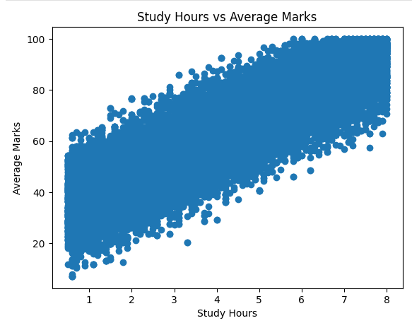
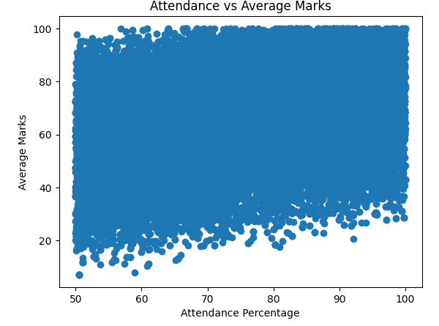
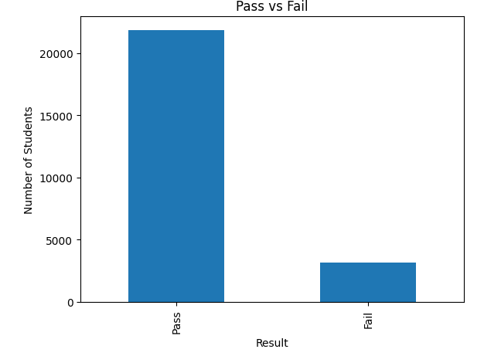
Graphs and Visualisations
Bar chart showing score comparison
Line or bar graph for study time vs performance
Distribution of student scores
Visual insights for better understanding

Slide 8
Conclusion
Student performance is influenced by multiple factors
Data analysis helps identify useful patterns
Visualizations make results easy to understand
This project provides basic insights into academic performance

Slide 9
Thankyou
kopparthinishyavika@gmail.com - questions ?

